Slide 1
A Decade of Charter School Growth within School District Attendance Areas
Eric Berschback, Kelly Powell;
Center for Student Achievement
2016 AERO

Slide 2
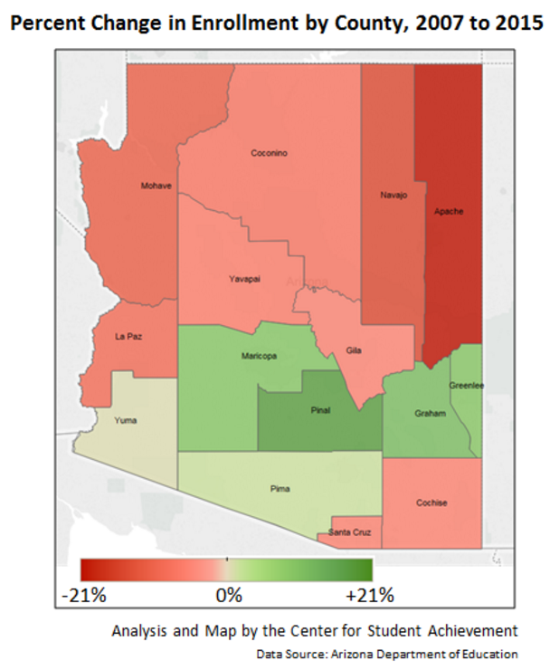
The Challenge:
Going within the county level to improve our view of charter school growth.
Notes:
It would be nice to have a map like the one pictured, except at the district level. It’s fairly easy to do with district schools

Slide 3
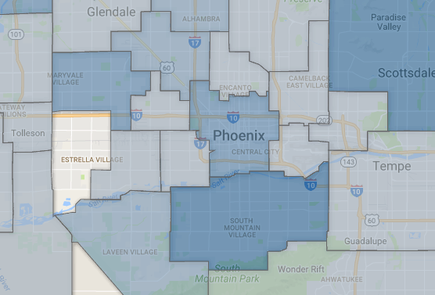
The Idea:
Compare 2006 and 2015 ADM files with school districts as attendance area boundaries.
In which district does each charter school “sit”?
Notes:
Using Tableau and Google Fusion Tables

Slide 4
Using School Districts as “Attendance Areas”
Example
School | LEA | Sector | LEA Type
T. G. Barr School | Roosevelt Elementary District | District | Elementary
South Mountain HS | Phoenix Union High School District | District | Union High School
Sequoia Choice Precision School | Edkey, Inc. - Sequoia Choice Schools | Charter | Charter

Slide 5
Using School Districts as “Attendance Areas”
Example
School | LEA | Geo Elementary District
T. G. Barr School | Roosevelt Elementary District | Roosevelt Elementary District
South Mountain HS | Phoenix Union High School District | Roosevelt Elementary District
Sequoia Choice Precision School | Edkey, Inc. - Sequoia Choice Schools | Roosevelt Elementary District

Slide 6
Using School Districts as “Attendance Areas”
Example
School | LEA | 2006 ADM | 2015 ADM
T. G. Barr School | Roosevelt Elementary District | 440 | 488
South Mountain HS | Phoenix Union High School District | 2082 | 1674
Sequoia Choice Precision School | Edkey, Inc. - Sequoia Choice Schools |  | 59

Slide 7
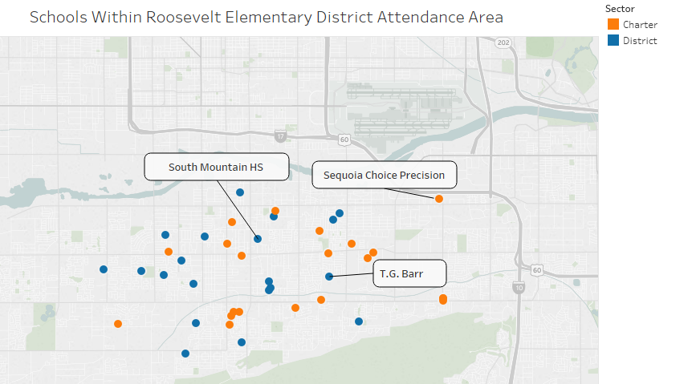
Notes:
Here are the district AND charter schools that sit within the boundaries of Roosevelt Elementary district. Notice there is even a HS in this set, as we are using the elementary district as the most granular geo boundary possible. South Mountain HS is actually in Phoenix Union HSD, but for this analysis, they are considered to be in the attendance area of Roosevelt Elementary District

Slide 8
Challenges and Limitations to the Data
Due to the scope of the work and the geographic nature of the project, this analysis does not include…
JTEDs
Accommodation schools/districts
BIA schools
Online schools

Slide 9
Challenges and Limitations to the Data
Example
School | LEA | 2006 ADM | 2015 ADM
T. G. Barr School | Roosevelt Elementary District | 440 | 488
South Mountain HS | Phoenix Union High School District | 2082 | 1674
Sequoia Choice Precision School | Edkey, Inc. - Sequoia Choice Schools |  | 59

Slide 10
Challenges and Limitations to the Data
2006 ADM
2015 ADM
If a charter school was still active in 2015, we have its geographic location. If it was not active in 2015, we did not assign it to a geographic district.
1922 schools
1404 district
518 charter
Geo info on all schools

Slide 11
Challenges and Limitations to the Data
2006 ADM
2015 ADM
1882 schools
1409 district
473 charter
1922 schools
1404 district
518 charter
Geo info on all schools
174 charter Entity IDs are no longer in use

Slide 12
Using School Districts as “Attendance Areas”
Example
School | LEA | Sector | LEA Type
T. G. Barr School | Roosevelt Elementary District | District | Elementary
South Mountain HS | Phoenix Union High School District | District | Union High School
Sequoia Choice Precision School | Edkey, Inc. - Sequoia Choice Schools | Charter | Charter
Esperanza Montessori | Espiritu Community Development Corp. | Charter | Charter

Slide 13
Using School Districts as “Attendance Areas”
Example
School | LEA | Geo Elementary District
T. G. Barr School | Roosevelt Elementary District | Roosevelt Elementary
South Mountain HS | Phoenix Union High School District | Roosevelt Elementary
Sequoia Choice Precision School | Edkey, Inc. - Sequoia Choice Schools | Roosevelt Elementary
Esperanza Montessori | Espiritu Community Development Corp. | Roosevelt Elementary

Slide 14
Using School Districts as “Attendance Areas”
Example
School | LEA | 2006 ADM | 2015 ADM
T. G. Barr School | Roosevelt Elementary District | 440 | 488
South Mountain HS | Phoenix Union High School District | 2082 | 1674
Sequoia Choice Precision School | Edkey, Inc. - Sequoia Choice Schools |  | 59
Esperanza Montessori | Espiritu Community Development Corp. | 318 | Consolidated

Slide 16
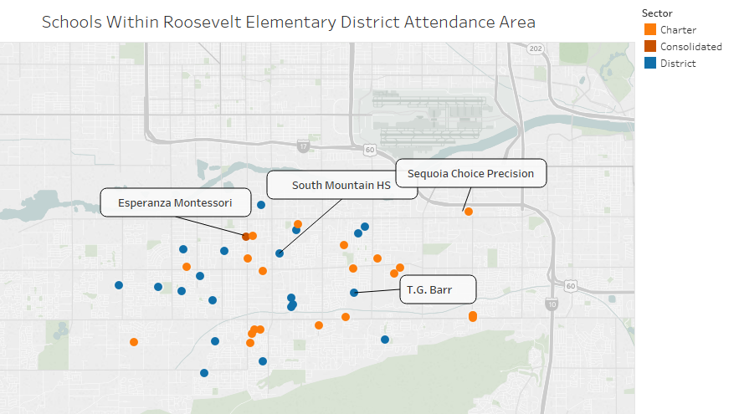

Slide 17
We considered…
The change in the number of charter schools within an attendance area
The change in charter ADM within an attendance area
The proportion of charter-to-district ADM in the 2015 ADM file

Slide 18
Results and Findings

Slide 19
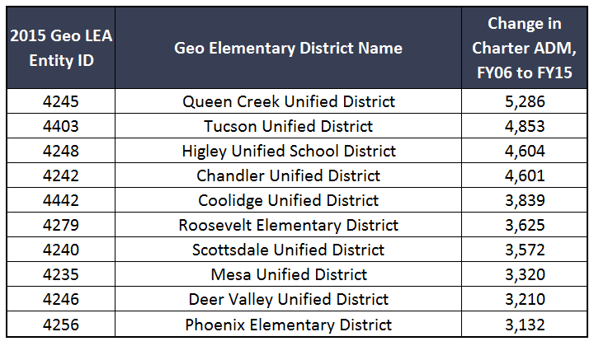
Change in ADM

Slide 20
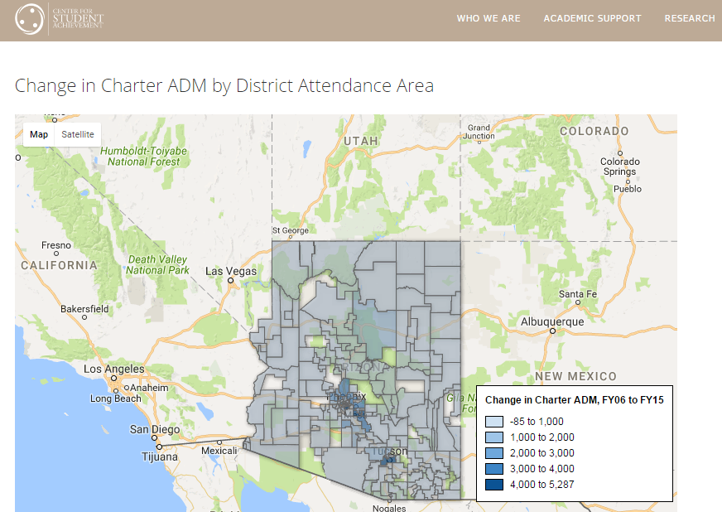
CenterForStudentAchievement.org/eric

Slide 21
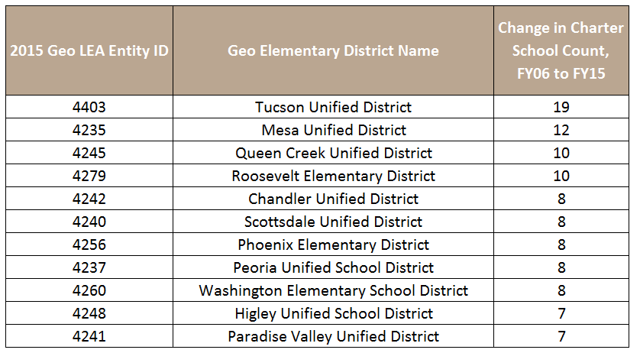
Change in Number of Charter Schools

Slide 22
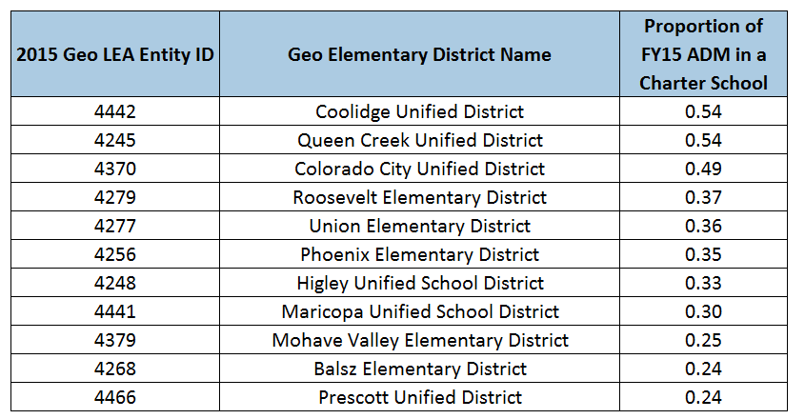
Proportion of Charter School ADM, FY15

Slide 23
Moving Forward:
A historical/longitudinal sense of how and where charter schools are growing.

Slide 24
Acknowledgements
Dr. Anabel Aportela

Slide 25
Questions?
Eric Berschback
Kelly Powell
eric@centerforstudentachievement.org
kelly@centerforstudentachievement.org

Slide 26
APPENDIX
174 Charter Schools without 2015 Entity IDs
http://azredistricting.org/districtlocator/

